Slide 1





VAWA Offense Statistics for Clery Act Purposes
2nd Annual Mid-Year Conference
Michael M. DeBowes, Ph.D.
Director of Research & Strategic Initiatives
NACCOP
Adrienne Meador Murray
Director, Training & Compliance Activities
NACCOP

Slide 2
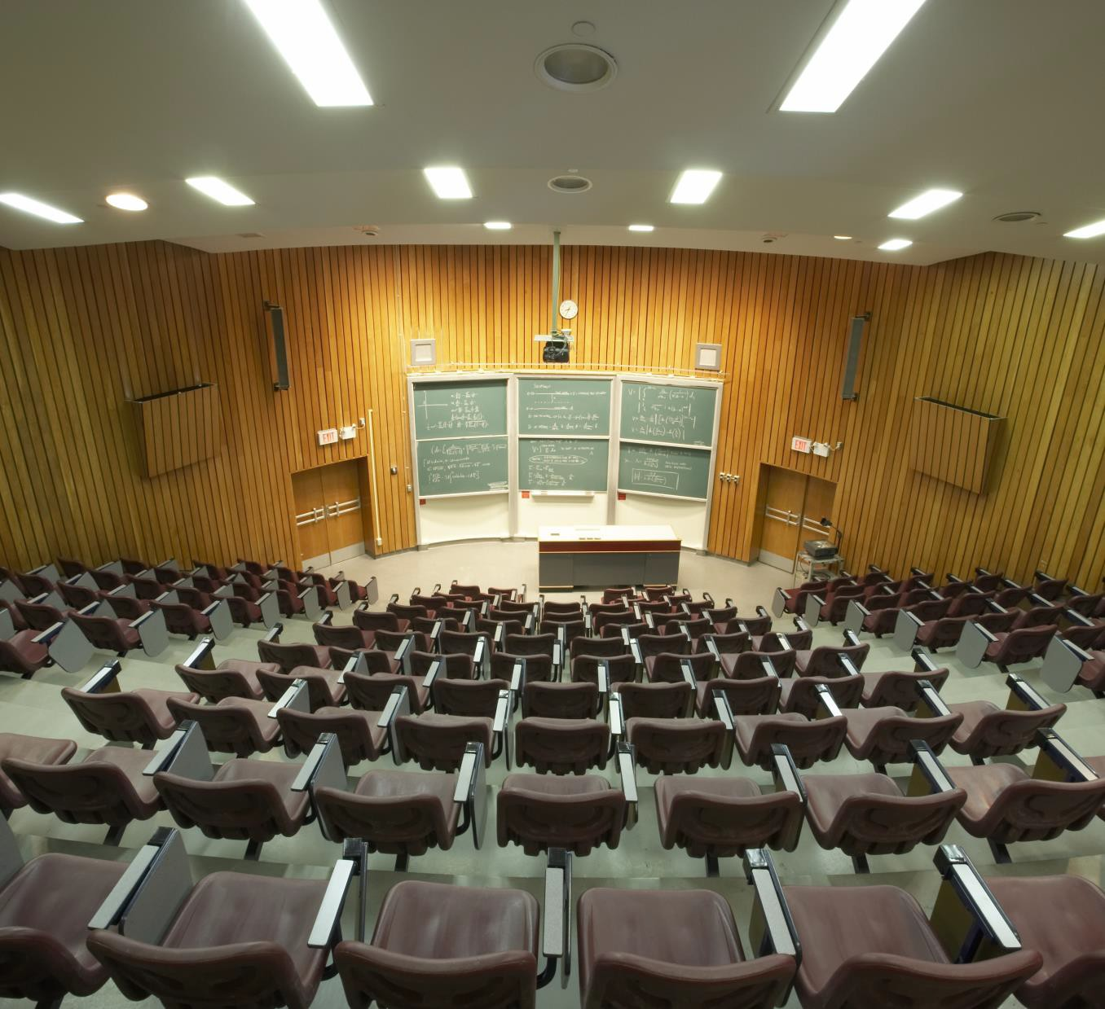
CLERY ACT FOUNDATIONS
2023 NACCOP 2ND ANNUAL MID-YEAR CONFERENCE
2

Slide 3

Three Part Test
Was the crime reported to a Campus Security Authority?
Is the crime a Clery crime?
Did the crime occur on or within the institution’s reportable Clery
Geography?
2023 NACCOP 2ND ANNUAL MID-YEAR CONFERENCE

Slide 4




Campus Security Authorities (CSAs)
Group 1: Campus Police/Security Department
Personnel
Group 2: Individuals with security-related responsibilities
Group 3: Individuals or organizations to which students/employees should report crimes
Group 4: Institutional officials with significant responsibility for student and campus activities
2023 NACCOP 2ND ANNUAL MID-YEAR CONFERENCE

Slide 5
A CSA’s Primary Responsibility is...
to promptly report allegations of Clery Act crimes they receive to the reporting structure established by the institution.
2023 NACCOP 2ND ANNUAL MID-YEAR CONFERENCE

Slide 6
CSA Reminder from Baylor FPRD
“…it is incumbent upon CSAs to obtain as much information as possible when it is made available to them as that report could be [the institution’s] one and only opportunity to obtain all the information concerning a crime or incident if the complainant refuses to report it to [the campus police or security department].”
(Baylor University Final Program Review Determination, 2020, p. 33)
2023 NACCOP 2ND ANNUAL MID-YEAR CONFERENCE

Slide 7
Clery Geography
The Clery Act requires institutions to disclose statistics for select crimes that occur:
  On Campus,
  on Public Property within or immediately adjacent to and accessible from the campus, and
  in or on Noncampus Buildings or Property that the institution (or an officially recognized student organization) owns or controls
On-Campus Student Housing Facilities are a subset of the On-Campus category
Institutions may have Separate Campus locations as well
2023 NACCOP 2ND ANNUAL MID-YEAR CONFERENCE

Slide 8
Clery Act Crimes
Primary Crimes
Arrests and Referrals
for Disciplinary Action
  Liquor Law Violations
  Drug Law Violations
  Weapon Law Violations
Hate Crimes
  All Primary Crimes (except Manslaughter by Negligence)
  Larceny-Theft
  Simple Assault
  Intimidation
  Destruction/Vandalism/Damage of Property
Murder/Non-negligent Manslaughter
Manslaughter by Negligence
◾
Sexual Assault (Rape, Fondling, Incest &
Statutory Rape)
Robbery
Aggravated Assault
Burglary
Motor Vehicle Theft
Arson
VAWA Offenses
◾
◾
◾
Dating Violence
Domestic Violence
Stalking
+ Unfounded Crimes
2023 NACCOP 2ND ANNUAL MID-YEAR CONFERENCE
8

Slide 9
Clery Crime Definitions
Use the definitions provided in the Clery Act’s implementing regulations
  VAWA Offense definitions can be found at 34 CFR 668.46(a)
  All other crime definitions can be found in Appendix A to Subpart D of Part 668 - Crime Definitions in Accordance With the Federal Bureau of Investigation's Uniform Crime Reporting Program
2023 NACCOP 2ND ANNUAL MID-YEAR CONFERENCE

Slide 10
A crime is reported when…
it is brought to the attention of a CSA.
2023 NACCOP 2ND ANNUAL MID-YEAR CONFERENCE

Slide 11

Key Classification Considerations
Affiliation of parties do not matter (except for
LDW referrals)
No corroboration necessary or required
Do not discount attempts
Outcome independent
  Investigation/adjudication not required to classify/count a reported crime
All reported Clery crimes occurring within Clery Geography must be included in the statistics
  Special case of Unfounded offenses
This Photo by Unknown Author is licensed under CC BY-NC
2023 NACCOP 2ND ANNUAL MID-YEAR CONFERENCE

Slide 12
Key Process Considerations
There must be procedures in place to ensure CSAs promptly report crimes to the reporting structure of the institution
  Align procedures with Annual Security Report disclosure(s)
  Develop a mechanism CSAs can use to document and forward crime reports to the reporting structure
    Consider how the reporting structure may differ for certain CSAs, including the preferred receivers of reports (e.g., residence life personnel or Title IX Coordinator)
2023 NACCOP 2ND ANNUAL MID-YEAR CONFERENCE

Slide 13
Responsibility for Classifying Offenses
"The Department [of Education] must emphasize that the proper classification of an incident is not in any regard dependent on the label that a victim or witness uses to describe it. Rather, a competent institutional official with the requisite knowledge and experience must evaluate the available information and determine the crime classification(s) that apply
to the particular set of case facts” (University of
Saint Thomas FPRD, 2017, p. 10).
2023 NACCOP 2ND ANNUAL MID-YEAR CONFERENCE

Slide 14







When a CSA Reports a Crime…
Annual Statistical Disclosures
Daily Crime Log
Assess for Timely Warning
Initial Crime Report
2023 NACCOP 2ND ANNUAL MID-YEAR CONFERENCE

Slide 15
THE BASICS OF TITLE IX
2023 NACCOP 2ND ANNUAL MID-YEAR CONFERENCE
15

Slide 16
Determining Title IX Applicability
Offense Meets Title IX Definition
Jurisdiction of Person
Participation in the Educational Program
Offense occurs in the Context of the Program
2023 NACCOP 2ND ANNUAL MID-YEAR CONFERENCE
16

Slide 17

SEXUAL HARASSMENT DEFINITIONS
2023 NACCOP 2ND ANNUAL MID-YEAR CONFERENCE
17

Slide 18
§ 106.30(A) - SEXUAL HARASSMENT
Sexual harassment means conduct on the basis of sex that satisfies one or more of the following:
1. An employee of the recipient conditioning the provision of an aid, benefit, or service of the recipient on an individual’s participation in unwelcome sexual conduct;
2. Unwelcome conduct determined by a reasonable person to be so severe, pervasive, and objectively offensive that it effectively denies a person equal access to the recipient’s education program or activity;
3. “Sexual assault” as defined in 20 U.S.C. 1092(f)(6)(A)(v), “dating violence”
as defined in 34 U.S.C. 12291(a)(10), “domestic violence” as defined in 34
U.S.C. 12291(a)(8), or “stalking” as defined in 34 U.S.C. 12291(a)(30).
2023 NACCOP 2ND ANNUAL MID-YEAR CONFERENCE
18

Slide 19







Sexual Assault
Rape
Fondling
Incest Statutory Rape
Intimate Partner Violence
Dating Violence
Domestic Violence
Stalking
§ 106.30(A) - THE VAWA OFFENSES
2023 NACCOP 2ND ANNUAL MID-YEAR CONFERENCE
19

Slide 20

20
SEXUAL ASSAULT
“SEXUAL ASSAULT” AS DEFINED IN
20 U.S.C. 1092(F)(6)(A)(V)
2023 NACCOP 2ND ANNUAL MID-YEAR CONFERENCE

Slide 21














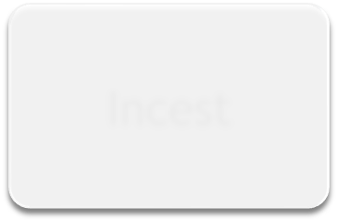

Sexual Assault
Forcible
Non-Forcible
Sexual Assault with Object
Rape
Sodomy
Fondling
Incest
Statutory Rape
2023 NACCOP 2ND ANNUAL MID-YEAR CONFERENCE

Slide 22
Option 1: Sexual Assault - Rape (From SRS)
Rape - The penetration, no matter how slight, of the vagina or anus, with any body part or object, or oral penetration by a sex organ of another person, without the consent of the victim.
2023 NACCOP 2ND ANNUAL MID-YEAR CONFERENCE

Slide 23
Sex Offenses, Forcible - Any sexual act directed against another person, without the consent of the victim including instances where the victim is incapable of giving consent.
Forcible Rape - (Except Statutory Rape) The carnal knowledge of a person, forcibly and/or against that person’s will or not forcibly or against the person’s will in instances where the victim is incapable of giving consent because of his/her temporary or permanent mental or physical incapacity.
Forcible Sodomy - Oral or anal sexual intercourse with another person,
forcibly and/or against that person’s will or not forcibly or against the person’s will in instances where the victim is incapable of giving consent because of his/her youth or because of his/her temporary or permanent mental or physical incapacity.
Sexual Assault With An Object - To use an object or instrument to unlawfully penetrate, however slightly, the genital or anal opening of the body of another person, forcibly and/or against that person’s will or not forcibly or against the person’s will in instances where the victim is incapable of giving consent because of his/her youth or because of his/her temporary or permanent mental or physical incapacity.
OPTION 2: SEXUAL ASSAULT-RAPE (FROM NIBRS)
2023 NACCOP 2ND ANNUAL MID-YEAR CONFERENCE
23

Slide 24
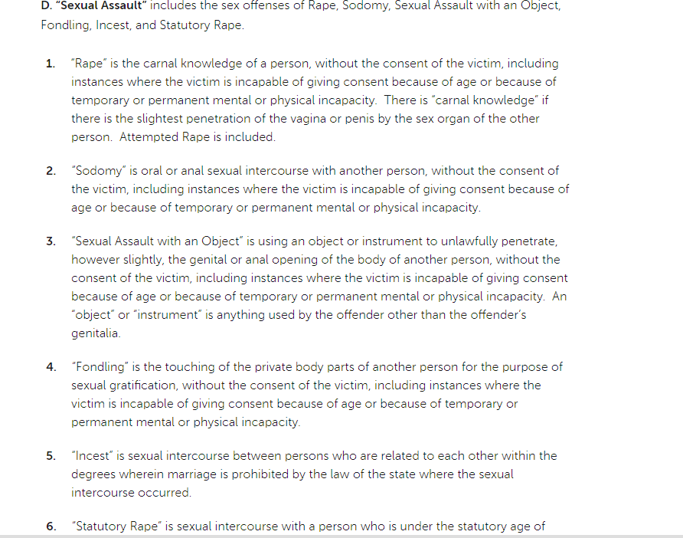
INSTITUTIONAL TITLE IX POLICY UTILIZING NIBRS
(AND IT’S OK!)
2023 NACCOP 2ND ANNUAL MID-YEAR CONFERENCE

Slide 25

QUESTION:
WHAT CHALLENGES DOES THIS POSE FOR TITLE IX COORDINATORS AND CLERY COMPLIANCE OFFICERS IN COMMUNICATING AND RECONCILING DATA?
2023 NACCOP 2ND ANNUAL MID-YEAR CONFERENCE

Slide 26
SEXUAL ASSAULT - FONDLING
Fondling - The touching of the private body parts of another person for the purpose of sexual gratification, without the consent of the victim, including instances where the victim is incapable of giving consent because of age or because of temporary or permanent mental incapacity.
2023 NACCOP 2ND ANNUAL MID-YEAR CONFERENCE
26

Slide 27

§ 106.30(a) - Consent
The Assistant Secretary will not require recipients to
adopt a particular definition of consent with respect to sexual assault.
2023 NACCOP 2ND ANNUAL MID-YEAR CONFERENCE
27

Slide 28
Includes attempts
Can broaden based on “consent” definition Can specify which body parts are “private” and
whether touching is over or under clothes
“Severity” of rape vs. fondling
Naming the offense in the policy
SEXUAL ASSAULT DEFINITION: CONSIDERATIONS IN TITLE IX
QUESTION: HOW DOES THIS IMPACT CLERY ACT STATISTICAL REPORTING?
2023 NACCOP 2ND ANNUAL MID-YEAR CONFERENCE
28

Slide 29
SEXUAL ASSAULT - INCEST & STATUTORY RAPE
Incest - Sexual intercourse between persons who are related to each other within the degrees wherein marriage is prohibited by law.
Statutory Rape - Sexual intercourse with a person who is under the statutory age of consent.
2023 NACCOP 2ND ANNUAL MID-YEAR CONFERENCE
29

Slide 30

INTIMATE PARTNER VIOLENCE
‘‘dating violence’’ as defined in 34 U.S.C.
12291(a)(10),
“domestic violence’’ as defined in 34 U.S.C.
12291(a)(8)
2023 NACCOP 2ND ANNUAL MID-YEAR CONFERENCE
30

Slide 31
DATING VIOLENCE - 34 U.S.C.
12291(A)(10)
The term ‘‘dating violence’’ means violence committed by a person— (A) who is or has been in a social relationship of a romantic or intimate nature with the victim; and (B) where the existence of such a relationship shall be determined based on a consideration of the following factors: (i) The length of the relationship. (ii) The type of relationship. (iii) The frequency of interaction between the persons involved in the relationship.
2023 NACCOP 2ND ANNUAL MID-YEAR CONFERENCE
31

Slide 32
DATING VIOLENCE - CLERY REGULATION ADDITIONS
(ii) For the purposes of this definition -
(A) Dating violence includes, but is not limited to,
sexual or physical abuse or the threat of such abuse.
(B) Dating violence does not include acts covered
under the definition of domestic violence.
2023 NACCOP 2ND ANNUAL MID-YEAR CONFERENCE
32

Slide 33
misdemeanor crimes of violence committed by -
The term ‘‘domestic violence’’ includes felony or
a current or former spouse or intimate partner of the victim,
a person with whom the victim shares a child in
common,
a person who is cohabitating with or has cohabitated with the victim as a spouse or intimate partner,
a person similarly situated to a spouse of the victim under the domestic or family violence laws of the jurisdiction receiving grant monies, or
any other person against an adult or youth victim who is protected from that person’s acts under the domestic or family violence laws of the jurisdiction.
DOMESTIC VIOLENCE - 34 U.S.C.
12291(A)(8)
2023 NACCOP 2ND ANNUAL MID-YEAR CONFERENCE
33

Slide 34

STALKING
“STALKING” AS DEFINED IN
34 U.S.C. 12291(A)(30)
2023 NACCOP 2ND ANNUAL MID-YEAR CONFERENCE
34

Slide 35
STALKING - 34 U.S.C.
12291(A)(30)
Engaging in a course of conduct directed at a specific person that would cause a reasonable person to—
Fear for the person’s safety or the safety of others;
or
Suffer substantial emotional distress.
2023 NACCOP 2ND ANNUAL MID-YEAR CONFERENCE
35

Slide 36
(ii) For the purposes of this definition -
  (A) Course of conduct means two or more acts, including, but not limited to, acts in which the stalker directly, indirectly, or through third parties, by any action, method, device, or means, follows, monitors, observes, surveils, threatens, or communicates to or about a person, or interferes with a person's property.
  (B) Reasonable person means a reasonable person under similar circumstances and with similar identities to the victim.
  (C) Substantial emotional distress means significant mental suffering or anguish that may, but does not necessarily, require medical or other professional treatment or counseling.
STALKING - CLERY REGULATION ADDITIONS
2023 NACCOP 2ND ANNUAL MID-YEAR CONFERENCE
36

Slide 37



Title IX Jurisdiction - Person
At the time of filing a formal complaint…the complainant must be participating in or attempting to participate in the education program or activity.” (§106.30(a))
The recipient exercised substantial control over both the respondent and the context in which the sexual harassment occurs.
2023 NACCOP 2ND ANNUAL MID-YEAR CONFERENCE

Slide 38
“Attempting to Participate”
Has withdrawn due to alleged harassment and has desire to re- enroll
Has graduated but intends to apply to new program or participate in alumni programs
Is on a leave of absence and still enrolled or intends to re-apply
Has applied for admission
2023 NACCOP 2ND ANNUAL MID-YEAR CONFERENCE

Slide 39





Title IX Jurisdiction – Context of Educational Programs or Activities
Locations, events or circumstances in which the institution has control over the respondent AND context
Or
Any building owned or controlled by a student organization that is officially recognized
And
Occurred in the United States
2023 NACCOP 2nd ANNUAL MID-YEAR CONFERENCE

Slide 40

RECEIVING REPORTS-WHO ARE TITLE IX REPORTERS
2023 NACCOP 2nd ANNUAL MID-YEAR CONFERENCE

Slide 41






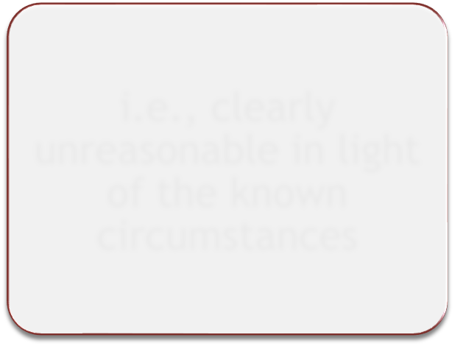


§ 106.44(a) - General Response to Sexual Harassment
Not Deliberately
Indifferent
Prompt
Equitable
Offer supportive measures to complainant
i.e., clearly unreasonable in light of the known circumstances
Follow grievance process before imposing sanctions
2023 NACCOP 2ND ANNUAL MID-YEAR CONFERENCE

Slide 42




§ 106.30(a) - Actual Knowledge
Title IX Coordinator
Official with Authority
2023 NACCOP 2ND ANNUAL MID-YEAR CONFERENCE

Slide 43








No Actual Knowledge § 106.30(a)
Not just ability, obligation, or training to report
Not constructive notice
Not when respondent only has notice
Not vicarious
liability
2023 NACCOP 2ND ANNUAL MID-YEAR CONFERENCE

Slide 44

Who May Report (from the Q&A)
“A school may receive actual knowledge of sexual harassment from any person. There is no requirement that the person be participating in or attempting to participate in a school program or activity to report sexual harassment.”
  Complainant
  Friend
  Parent
  Witness
2023 NACCOP 2ND ANNUAL MID-YEAR CONFERENCE

Slide 45





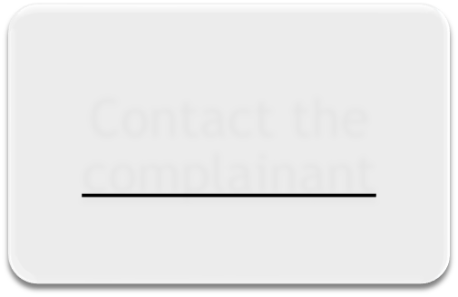


Response to a Report
The Title IX Coordinator must promptly
Explain the process for filing a formal complaint
Contact the complainant
Offer supportive measures
2023 NACCOP 2ND ANNUAL MID-YEAR CONFERENCE

Slide 46
REPORTING, DOCUMENTING & RECONCILING
2023 NACCOP 2ND ANNUAL MID-YEAR CONFERENCE
46

Slide 47

2023 NACCOP 2ND ANNUAL MID-YEAR CONFERENCE
47

Slide 48

1. Select the “Click Here to Evaluate” button in “My Schedule”
Session Evaluation
2. Or, visit
https://www.surveymonkey.com/r/NACCOPMid Year2023 to evaluate this session.
2023 NACCOP 2ND ANNUAL MID-YEAR CONFERENCE
48

